Slide 1
DATA WAREHOUSING (DWH)

Slide 2
AGENDA:
Definition
Why Data Warehousing ?
Types Of Data In DWH

Slide 3
DEFINITION:
The term "Data Warehouse" was first coined by Bill Inmon in 1990. According to Inmon, a data warehouse is a subject oriented, integrated, time-variant, and non-volatile collection of data. This data helps analysts to take informed decisions in an organization.

Slide 4
Subject Oriented:
Data warehouses are designed to help you analyze data. For example, to learn more about your company's sales data, you can build a warehouse that concentrates on sales. Using this warehouse, you can answer questions like "Who was our best customer for this item last year?" This ability to define a data warehouse by subject matter, sales in this case, makes the data warehouse subject oriented.

Slide 5
Integrated:
Integration is closely related to subject orientation. Data warehouses must put data from disparate sources into a consistent format. They must resolve such problems as naming conflicts and inconsistencies among units of measure. When they achieve this, they are said to be integrated.

Slide 6
Time Variant:
In order to discover trends in business, analysts need large amounts of data. This is very much in contrast to online transaction processing (OLTP) systems, where performance requirements demand that historical data be moved to an archive. A data warehouse's focus on change over time is what is meant by the term time variant.

Slide 7
Non-Volatile :
Nonvolatile means that, once entered into the warehouse, data should not change. This is logical because the purpose of a warehouse is to enable you to analyze what has occurred.

Slide 8
NEED OF DWH :
For a company to be successful in the future, they must make good decisions. And to make good decisions requires all relevant data to be taking into consideration. And the best source for that data is a well-designed data warehouse.

Slide 9
Types Of Data In DWH :
Operational
Data
Strategic
Data

Slide 10
OPERATIONAL DATA:
Information on direct competitors, a company's labor statistics, information on suppliers, accounting data and projection of needed resources may all be included in operational data. Data collected on direct competitors helps marketers make the products seem superior to competing products. Data on customers helps marketers create consumer profiles that help with everything from product creation, to distribution and advertising. Labor and accounting data help with internal control of finances and productivity.

Slide 11
Strategic Data:
Both strategic and operational data aid in a type of strategic analysis know as SWOT, which stands for strengths, weaknesses, opportunities and threats. SWOT analysis helps companies determine the business's strategic direction and set strategic goals. Strategic data also helps keep marketers in tune with trends, which helps create in-demand products and appealing advertisements. Labor statistics inform upper management of general trends among employees and aids management in enduring the workforce's commitment to the company's strategic goals.

Slide 12
META DATA :
Metadata is simply defined as data about data. The data that is used to represent other data is known as metadata. For example, the index of a book serves as a metadata for the contents in the book. In other words, we can say that metadata is the summarized data that leads us to detailed data. In terms of data warehouse, we can define metadata as follows.
Metadata is the road-map to a data warehouse.
Metadata in a data warehouse defines the warehouse objects.
Metadata acts as a directory. This directory helps the decision support system to locate the contents of a data warehouse.

Slide 13
OLAP: (Online Analytical Processing Server)
Online Analytical Processing Server (OLAP) is based on the multidimensional data model. It allows managers, and analysts to get an insight of the information through fast, consistent, and interactive access to information.

Slide 14
Types of OLAP Servers:
We have four types of OLAP servers −
Relational OLAP (ROLAP)
Multidimensional OLAP (MOLAP)
Hybrid OLAP (HOLAP)
Specialized SQL Servers

Slide 15
Relational OLAP (ROLAP)
ROLAP servers are placed between relational back-end server and client front-end tools. To store and manage warehouse data, ROLAP uses relational or extended-relational DBMS.

Slide 16
Multidimensional OLAP:
MOLAP uses array-based multidimensional storage engines for multidimensional views of data. With multidimensional data stores, the storage utilization may be low if the data set is sparse. Therefore, many MOLAP server use two levels of data storage representation to handle dense and sparse data sets.

Slide 17
Hybrid OLAP :
Hybrid OLAP is a combination of both ROLAP and MOLAP. It offers higher scalability of ROLAP and faster computation of MOLAP. HOLAP servers allows to store the large data volumes of detailed information. The aggregations are stored separately in MOLAP store.

Slide 18
Specialized SQL Servers
Specialized SQL servers provide advanced query language and query processing support for SQL queries over star and snowflake schemas in a read-only environment.

Slide 19
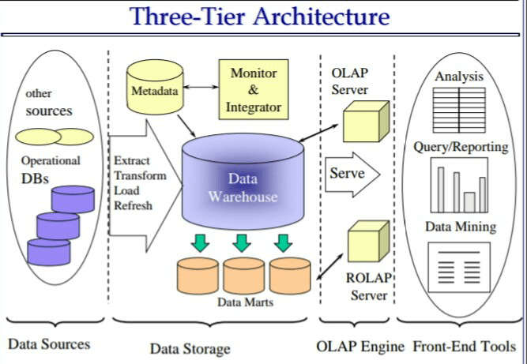
Architecture :

Slide 20

Questions ? And Answers !

Slide 21
Quick Revision :
Define data warehouse?
What is the very basic difference between data warehouse and operational databases?

Slide 22





Thank You !
/iamkumarji
/shubhambanarasi

